Slide 1

Title: Enhancing Operational Efficiency in a Multi-Specialty Hospital
Name: Buddharatna.H
Designation: Business Analyst

Slide 2

Case study overview
You have recently been hired as a Business Analyst by HealthFirst Care, a leading multi-specialty hospital renowned for its high-quality patient care and advanced medical facilities.
The hospital has launched an initiative to enhance the overall patient experience in light of increasing patient complaints and operational challenges.

Slide 3
Case study overview
The management has identified key areas for improvement, including:
Reducing wait times
Optimizing resource allocation
Improving communication between stakeholders

Slide 4





Task overview
As a Business Analyst, you have been tasked with driving this initiative. Your role will involve:
Gathering stakeholder requirements
Analyzing existing processes
Developing data-driven solutions to improve operational efficiency
Developing risk assessment and mitigation plan

Slide 5

Task 1
Task 1

Slide 6
Business Requirement Document (BRD)
A BRD defines the business objectives, project scope, key requirements, stakeholder expectations, and deliverables for a project. Your task includes writing the following:
Problem statement
Key requirements to improve operational efficiency
Constraints
Acceptance criteria
Long wait times for patients due to poor scheduling and overbooking.
Inefficient resource allocation, causing delays in care and overburdening of staff.
Communication gaps between departments and with patients, leading to missed information, duplication of efforts, and delayed care.
Online appointment system with real-time availability and scheduling.
SMS/email notification system for appointment confirmations, delays, and updates.
Resource management dashboard for staff and room allocations.
Patient record system with streamlined access and updates.
Automate appointment scheduling and reduce double bookings
Budget limitations may affect the extent of system upgrades.
Transition time may temporarily affect hospital operations.
Staff resistance to change may slow adoption of new systems.
Data migration challenges from legacy systems.
Alignment with core project objectives (wait time reduction, efficiency improvement).
Justification from data or stakeholder needs.
Feasibility within budget and timeline constraints.
No adverse compliance or operational risks.

Slide 7
Task 1
Task 2

Slide 8
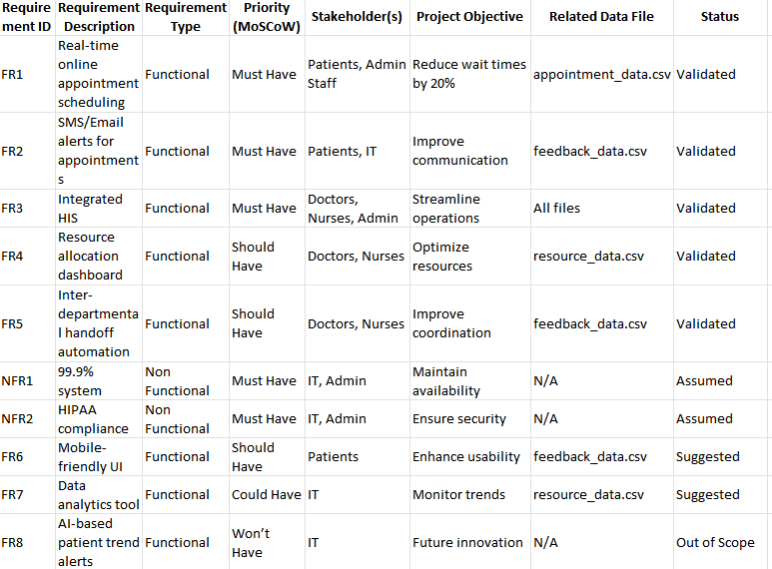
Requirement Traceability Matrix (RTM)
A Requirements Traceability Matrix maps and tracks project requirements throughout the lifecycle, ensuring that each requirement is addressed, tested, and aligned with business objectives, stakeholder needs, and project deliverables. You are required to add screenshot of your RTM that:
Categorize requirements into functional and non-functional
Categorize requirements using the MoSCoW method
List requirements based on priority

Slide 9
Task 1
Task 3

Slide 10

Stakeholder Analysis and Engagement Plan
The Stakeholder Analysis and Engagement Plan identifies key stakeholders, understands their interests and influence, and develops strategies to effectively communicate, engage, and manage their expectations throughout the project lifecycle.
This Photo by Unknown Author is licensed under CC BY-NC-ND

Slide 11
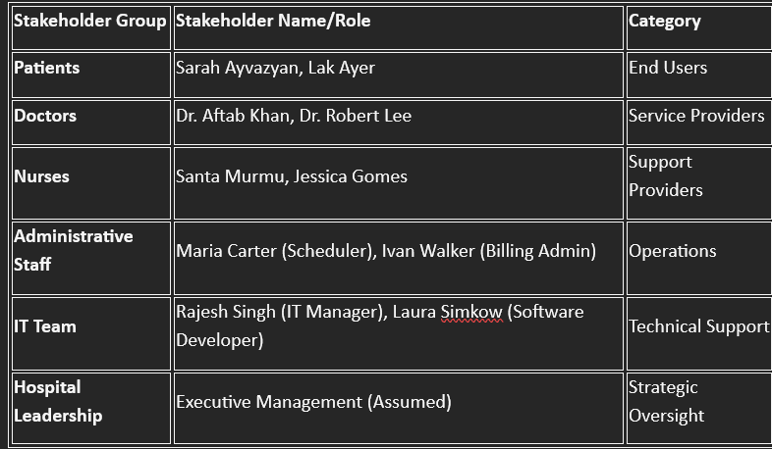
Identifying and documenting stakeholders

Slide 12
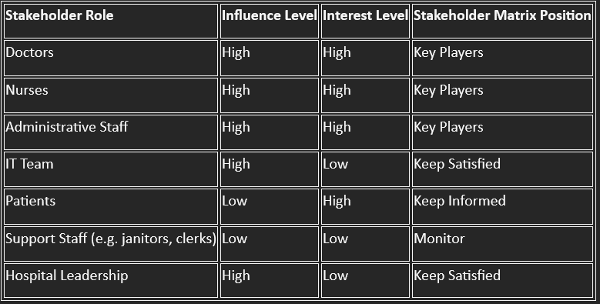
Categorizing stakeholders’ influence as high, medium, or low

Slide 13
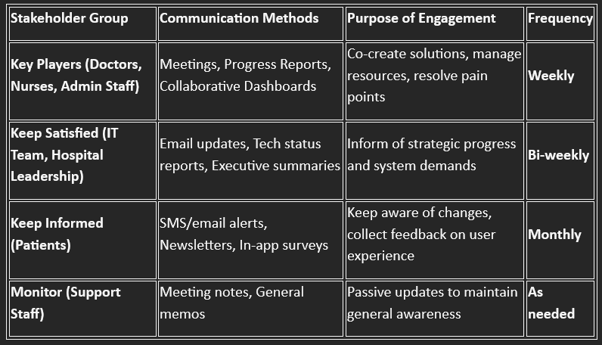
Listing stakeholder engagement strategies

Slide 14
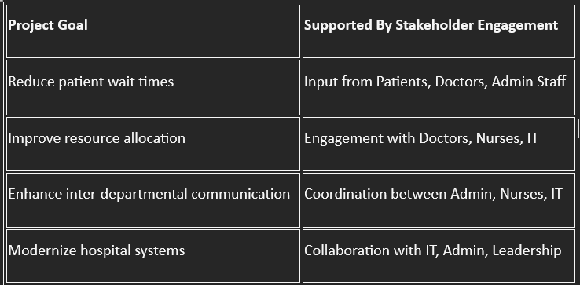
Alignment with Project Goals

Slide 15
Task 1
Task 4

Slide 16
Scope Management Plan
The Scope Management Plan defines how the project scope will be planned, documented, validated, and controlled to ensure that all project objectives and deliverables are met while preventing scope creep. Your tasks include:
In-scope
Out-of-Scope
Automation of appointment scheduling, including online and in-clinic interfaces.
Integration of real-time SMS/email notification systems for patients and staff.
Implementation of dashboards to monitor equipment and staff resource utilization.
Data analysis of appointment, feedback, and resource datasets to identify bottlenecks.
Training staff on new systems and workflows.
Ensuring HIPAA and healthcare data compliance.
Hospital infrastructure upgrades (e.g., construction, physical expansions).
Recruitment of new clinical personnel.
Full electronic health record (EHR) overhaul (only limited integrations will be made).
Medical equipment procurement outside of the optimization tools.

Slide 17
Scope Management Plan
Constraints
Assumptions
Budget limitations for third-party software and IT upgrades.
Timeline constraint: Project must be completed within 6 months.
Regulatory compliance with HIPAA and local health data laws.
Limited availability of some stakeholders (doctors, nurses) due to duty shifts.
All stakeholders will be available for regular feedback cycles.
Provided datasets are accurate and complete.
Hospital leadership will support IT infrastructure upgrades and integration efforts.
Current IT systems are compatible for incremental upgrades and add-ons.

Slide 18
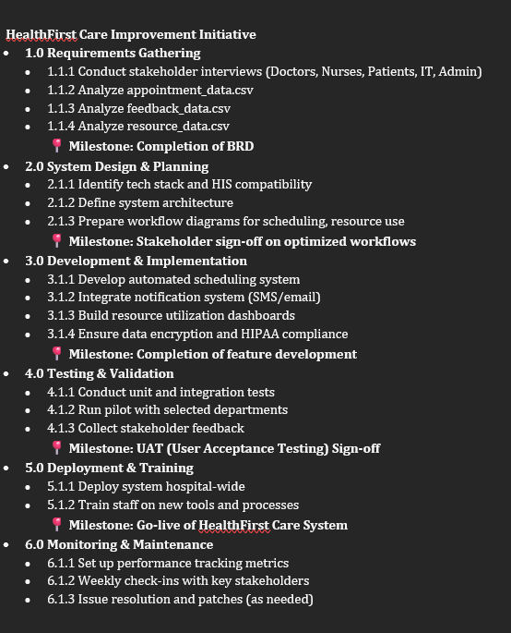
Scope Management Plan
Defining phases
in the Work
Breakdown Structure (WBS)

Slide 19
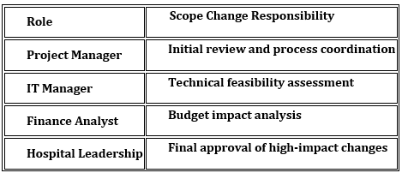
Scope Management Plan
Note Scope Change Management

Slide 20
Task 1
Task 5

Slide 21
Process Map Diagrams
Process | As-Is model | To-Be model
Appointment Scheduling | Manual slot checking leads to delays and frequent double bookings. Lack of integration between patient preferences and scheduling system. IT support often reacts to problems rather than preventing them. | Automated Scheduling with Conflict Detection Integrated platform to verify availability in real time. Notifications to patients via SMS/email reduce manual communication overhead.
Patient Check-in and Resource Allocation | Manual paperwork causes long queues and frustration. Roles of front desk and clinical staff often overlap, causing miscommunication. Resource availability (doctors, beds) is not tracked in real-time. | Streamlined Check-in via Kiosks Patients use self-service kiosks or mobile check-in to skip front-desk bottlenecks. Automated notification to doctors and nurses on patient arrival
Discharge Planning | Doctors and admin staff often work in silos, resulting in delayed discharges. Billing clearance is not integrated with the discharge summary process. Patient feedback collection is not timely or automated. | Discharge Workflow Optimization Trigger-based workflows using BPMN to automate summary generation and billing. Feedback captured immediately post-discharge using digital forms.

Slide 22
Task 1
Task 6

Slide 23
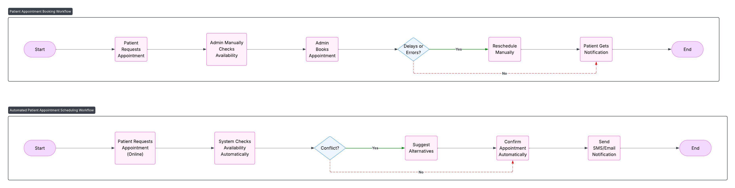
BPMN Diagrams
Workflow using Advanced BPMN Model

Slide 24
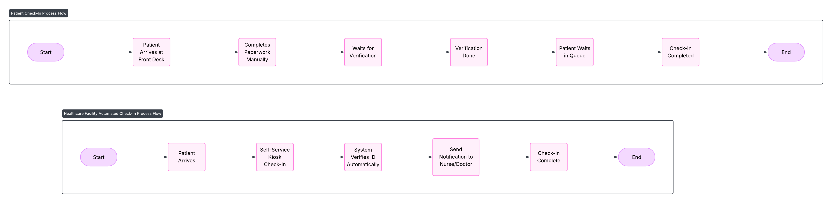
BPMN Diagrams
Workflow using Advanced BPMN Model

Slide 25
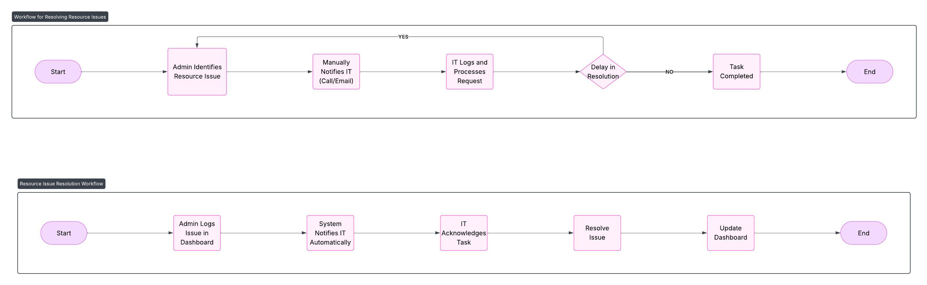
BPMN Diagrams
Workflow using Advanced BPMN Model

Slide 26
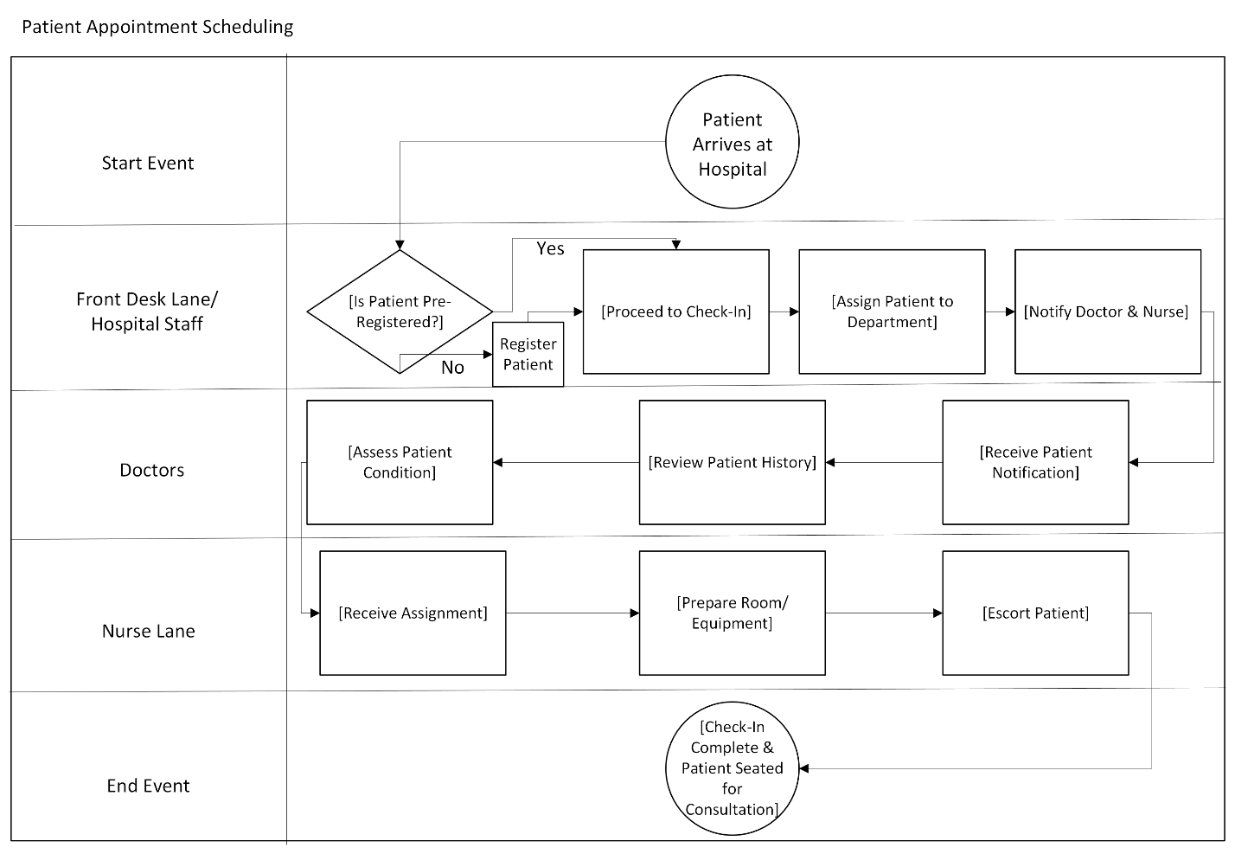
BPMN and Swimlane Diagrams
Stakeholder responsibilities using Swimlane diagram
:

Slide 27
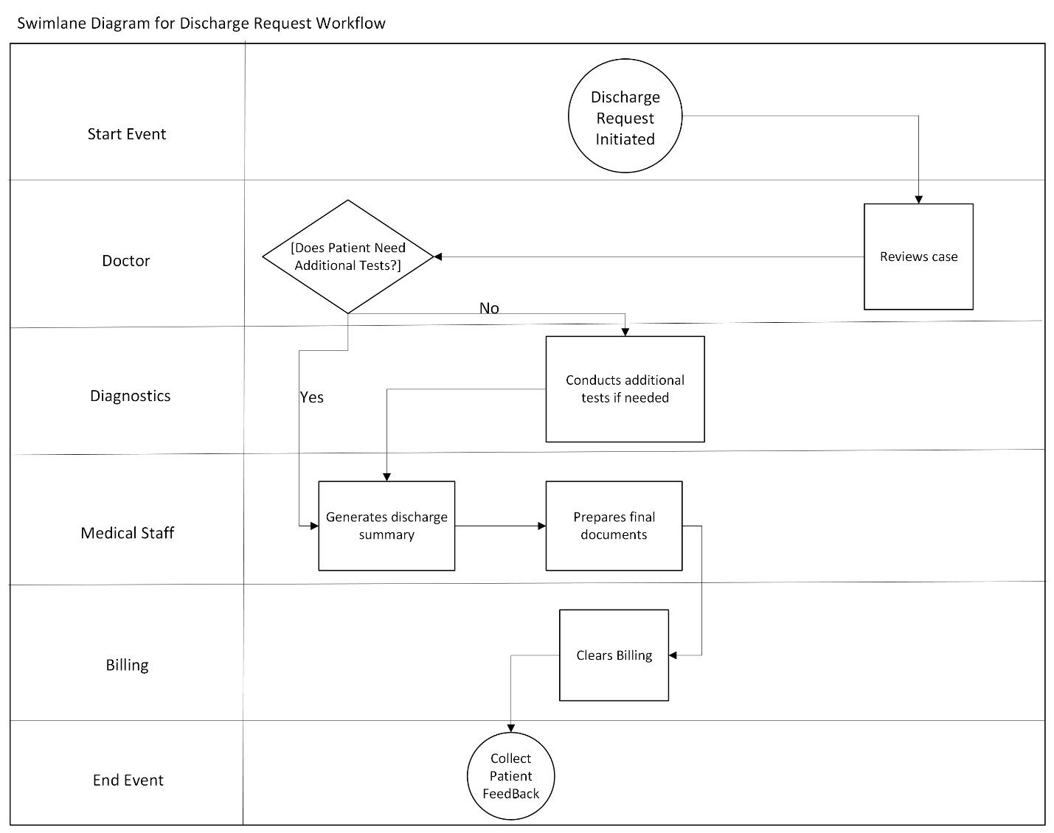
Swimlane Diagrams
Stakeholder responsibilities using Swimlane diagram
:

Slide 28
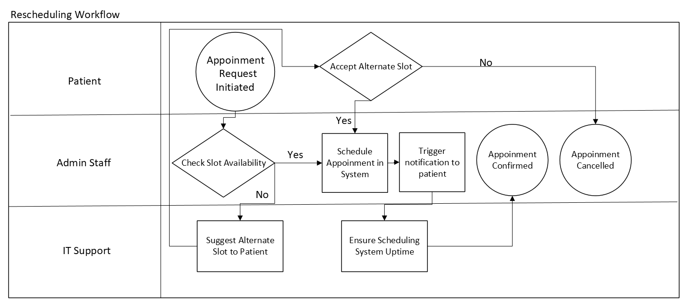
Swimlane Diagrams
Stakeholder responsibilities using Swimlane diagram
:

Slide 29
Task 1
Task 7

Slide 30
Data Analysis Document
The Data Analysis Document summarizes the key findings, trends, and insights derived from patient and resource data, providing evidence-based recommendations to enhance hospital operations and patient satisfaction. Your tasks include adding screenshots for the following:
Trends identified using Pivot Table
Analyzed trends
Key insights
[Add your screenshot here]
[Add your screenshot here]
[Add your screenshot here]

Slide 31
Task 1
Task 8

Slide 32
Dashboard
Dashboards visualize key operational metrics, such as patient wait times, resource utilization, and staff productivity, enabling data-driven decision-making for improved hospital efficiency and patient experience. Your task is to add the following screenshots:
Average patient wait time using a Line Chart
Bar Chart highlighting overused and underutilized resources
Patient feedback visualized using a Pie Chart
Heat Map showing the efficiencies of the departments
[Add your screenshot here]
[Add your screenshot here]
[Add your screenshot here]
[Add your screenshot here]

Slide 33
Task 1
Task 9

Slide 34
Risk Management Plan
The Risk Management Plan identifies, assesses, and mitigates potential risks—such as data privacy concerns, system integration challenges, and operational inefficiencies—to ensure smooth project execution and improved patient care. Your tasks include adding screenshots from your Risk Management plan based on the specified requirements:
Risks identified in the risk register
Categorized risks based on the Risk Assessment Matrix
Elements identified in the SWOT Analysis
Key insights
[Add your screenshot here]
[Add your response here]
[Add your response here]
[Add your response here]

Slide 35
Task 1
Task 10

Slide 36
Risk Mitigation Plan
The Risk Mitigation Plan identifies potential risks, assesses their impact, and implements strategies to minimize disruptions, ensuring smooth hospital operations and improved patient care. Your task includes adding screenshots from your Risk Mitigation plan based on the specified requirements:
Strategies to mitigate risks
Factors included in your Contingency Plan
Prioritized risks based on Visual Risk Matrix
Key insights from Risk Mitigation Plan
[Add your screenshot here]
[Add your screenshot here]
[Add your screenshot here]
[Add your screenshot here]

Slide 37
Risk Mitigation Plan
The Risk Mitigation Plan identifies potential risks, assesses their impact, and implements strategies to minimize disruptions, ensuring smooth hospital operations and improved patient care. Your task includes adding screenshots from your Risk Mitigation plan based on the specified requirements:
Strategies to mitigate risks
Factors included in your Contingency Plan
Prioritized risks based on Visual Risk Matrix
Key insights from Risk Mitigation Plan
[Add your screenshot here]
[Add your screenshot here]
[Add your screenshot here]
[Add your screenshot here]

Slide 38
Risk Mitigation Plan
The Risk Mitigation Plan identifies potential risks, assesses their impact, and implements strategies to minimize disruptions, ensuring smooth hospital operations and improved patient care. Your task includes adding screenshots from your Risk Mitigation plan based on the specified requirements:
Strategies to mitigate risks
Factors included in your Contingency Plan
Prioritized risks based on Visual Risk Matrix
Key insights from Risk Mitigation Plan
[Add your screenshot here]
[Add your screenshot here]
[Add your screenshot here]
[Add your screenshot here]

